Slide 1


UNIVERSITY, COLLEGE, AND SCHOOL REGISTRARS
ASSOCIATION (UCSRA), INC
GRADES PROCESSES and REQUEST OF DOCUMENTS
BY: DR. MYRA A. MARANA
“UCSRA PLUS ACTIVITY”
April 26, 2024
Performing Arts Theater, University of Perpetual Help System Laguna,
Sto. Niño, City of Biñan, Laguna

Slide 2
Grades
The Philippines has diverse university grading systems.

Slide 3



Grades Cycle & Processes
Input via assessment/testing (class standing)
Completion
Issuance of Student’s Records
Faculty
Registrar
Students
Computation
Encoding
Submission
Changing
Grading System
Verification/Validation
Grades Releasing
Modification
Analysis (GWA)
Reports/Submission
Safekeeping

Slide 4
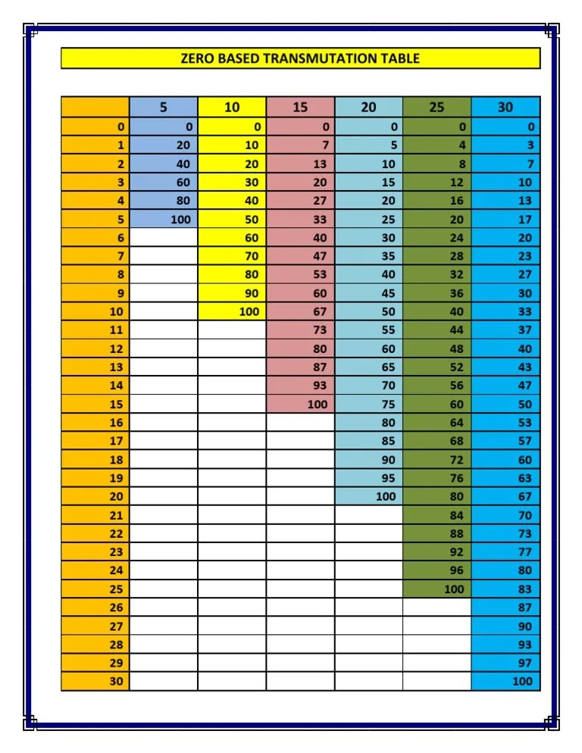
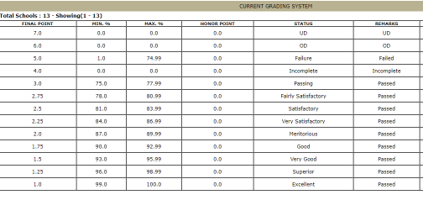
Grades Computation
Grading System
Base?
Percentage
Prelim (20%)
Midterm(30%)
Final(50%)
Rating Scale

Slide 5
Comparison Between the Grading System In Philippines & Other World Grading Systems
The grading systems in the Philippines and other countries vary significantly in terms of scale, grading criteria, and interpretation. Here, we will compare the grading systems of the Philippines with those of the United States, the United Kingdom, and Australia.
Country | Grading System | Highest Grade | Lowest Passing Grade
Philippines | 5-Point Scale (common) or 4-Point Scale (some universities) | 1.00 or 4.00 | 3.00 or 2.00
United States | Letter Grades (A+ to F) or Numeric Grades (0 to 100) | A+ or 100 | D or 60
United Kingdom | Numeric Grades (1 to 9 for GCSEs) or Letter Grades (A* to G for GCSEs and A to E for A-Levels) | 9 or A* | 4 or E
Australia | Letter Grades (HD, D, CR, P, F) | HD | P

Slide 6
Check out the basic grading system in college in the Philippines
Basic grading system in colleges in the Philippines
Grades | %age | Description (General) | USA Grading
1 | 99-100% | Excellent | 100-95=A+
1.25 | 96-98 | Outstanding | –
1.5 | 93-95 | Superior | 95-90=B+
1.75 | 90-92 | Very Good | –
2 | 87-89 | Good | 89-85=B
2.25 | 84-86 | Satisfactory | –
2.5 | 81-83 | Fairly Satisfactory | 84-80=C
2.75 | 78-80 | Fair | –
3 | 75-77 | Pass | –
5 | < 75 | Fail | F

Slide 7
GWA vs. GPA: The Distinction
GPA: Grasping the Grade Point Average
The GPA, or Grade Point Average, is a widely recognized metric used primarily in the United States and other countries, including Canada and Australia. It provides a standardized way to measure a student’s overall academic performance. GPA is calculated based on a student’s letter grades and the associated grade points assigned to each grade.
GWA: Decoding the General Weighted Average
In contrast, GWA, or General Weighted Average, is more commonly used in the Philippines and some other Asian countries. Like GPA, GWA is also a numerical representation of a student’s academic performance. However, the calculation method and grading scale may vary significantly from GPA.

Slide 8
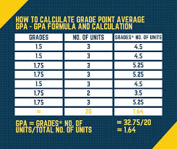
General Weighted Average
How do you calculate overall GWA?
To compute GWA: Multiply each grade by its credit units, sum the results, and divide by the total credit units.

Slide 9
Grades Encoding/Submission
Semestral grading sheets should be duly signed by the College Faculty & Dean every end of semester
Submission of grading sheets to the OUR must be right after the encoding schedule (which is 3 days after the last day of examination) for the prompt online viewing of grades.
EXAMINATIONS | EXAM DATE | ENCODING (3 DAYS) | COMCARD RELEASING/ONLINE VIEWING
PRELIMS | October 3 to 8, 2022 | October 10 to 12, 2022 | October 13, 2022 onwards
MIDTERM | November 14 to 19, 2022 | November 21 to 23, 2022 | November 24, 2022 onwards
PRE-FINALS | January 2 to 7, 2023 | January 9 to 11, 2023 | January 12, 2023 onwards
FINALS | January 9 to 14, 2023 | January 16 to 18, 2023 | January 19, 2023 onwards

Slide 10
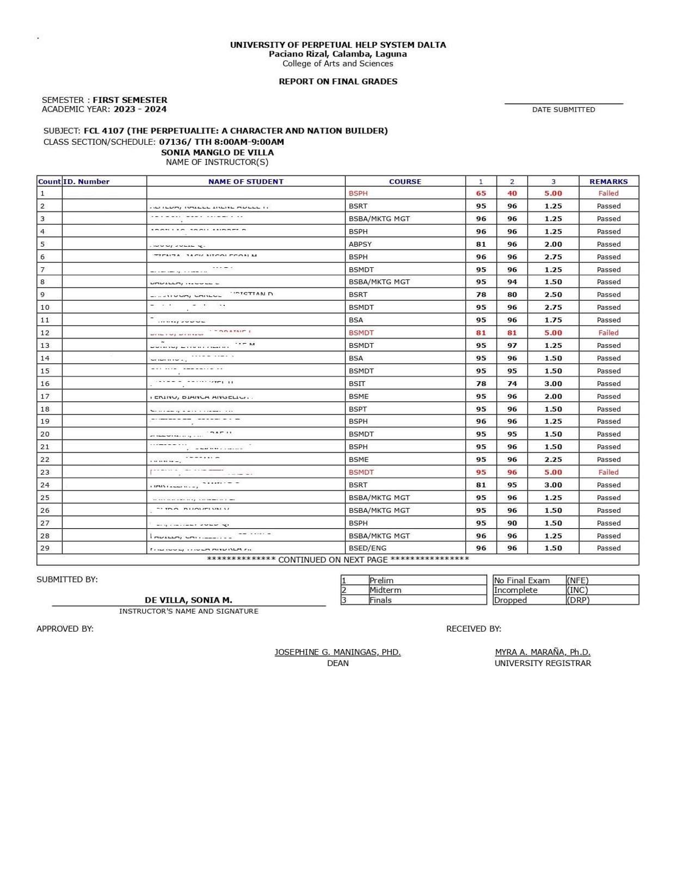
Grades Encoding/Submission
Grading sheets should be in triplicate copies (1 for the faculty, 1 for the Dean’s Office & 1 for the OUR)
Verification/Posting of grades will follow.
Sample: Grading Sheet

Slide 11
Late Encoding of Grades:
Request for School Automate re-opening
In case of late encoding of grades, faculty members may request for the reopening of their School Automate access.
Faculty members should prepare a letter stating the reason of late encoding and the specific date when they will be able to encode.
It should be signed by the College Dean and the University Registrar for approval of the School Director.
Signed & approved letter should be submitted to OUR & ITS for the reopening of access.

Slide 12
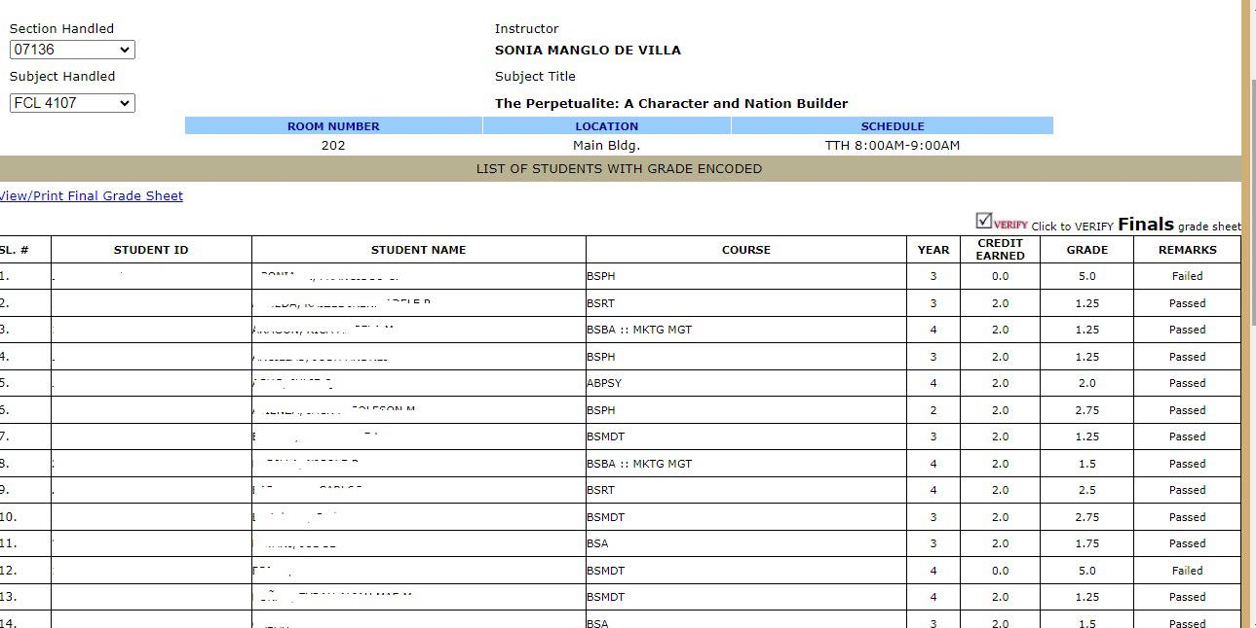
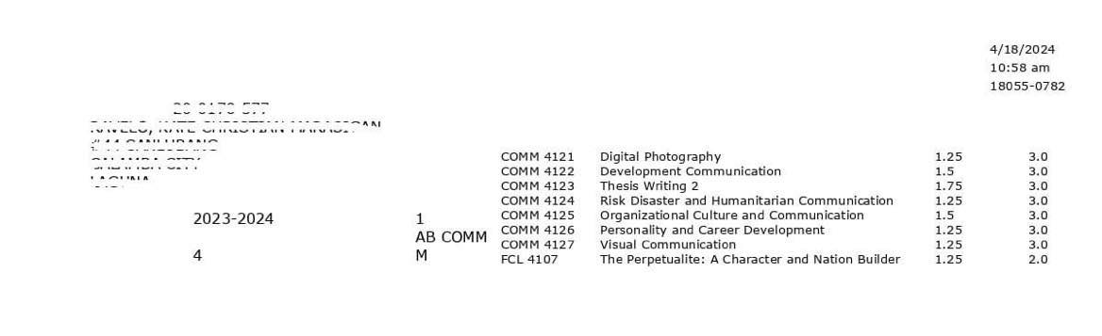
Verification / Validation of Grades:
SAMPLE Grading Sheet: Registrar’s View before validation
SAMPLE: Grading sheet for submission
SAMPLE ComCard: Student’s View after validation

Slide 13
Changing of Grades
It is a process whereby the encoded grades endorsed with finality by the teacher to the Registrar’s Office
are considered for revision due to a valid reason/s. (Erroneous Computation/Wrong entry in the encoding.)
Only the faculty concerned can request for the change of grades.
If the request is duly approved by the Change of Grades Committee.
Procedures:
The concerned faculty shall personally do the following
1. Fill-out a change of grade form and secure the signatures of the CGC
2. Submit the duly signed form to the Registrar’s Office.
3. The Registrar modify the grade as reflected in the Change of Grade Form; prints new copy of grading sheets
(triplicate); retain 1 copy and and provide 1 to the concerned faculty and 1 to the Dean.
Sources: UPHSD Faculty Manual 2018 Ed
: UPHSD Students’ Manual
: UPHSD Registrar’s Manual

Slide 14
Incomplete Grades and Completion Process
In general, our University does not give a Final Grade of “Incomplete”. But in Exceptional cases, an INC grade is given at the end of the semester for specific courses when a student:
is still in the process of completing requirements for Field Work, Practicum/OJT/Internship, RLE, Thesis/Research or other similar learning activities.
if student fails to complete academic requirements due to illness or other meritorious reasons approved by the Dean and School Director.
Students who receive an INC grade must apply for completion on or before the Final examination week within one (1) year.
The highest grade that students can receive from an approved Completion is 1.5.
INC grades that are not completed within the specified period is automatically converted to 5.0 or Failure by the system.

Slide 15
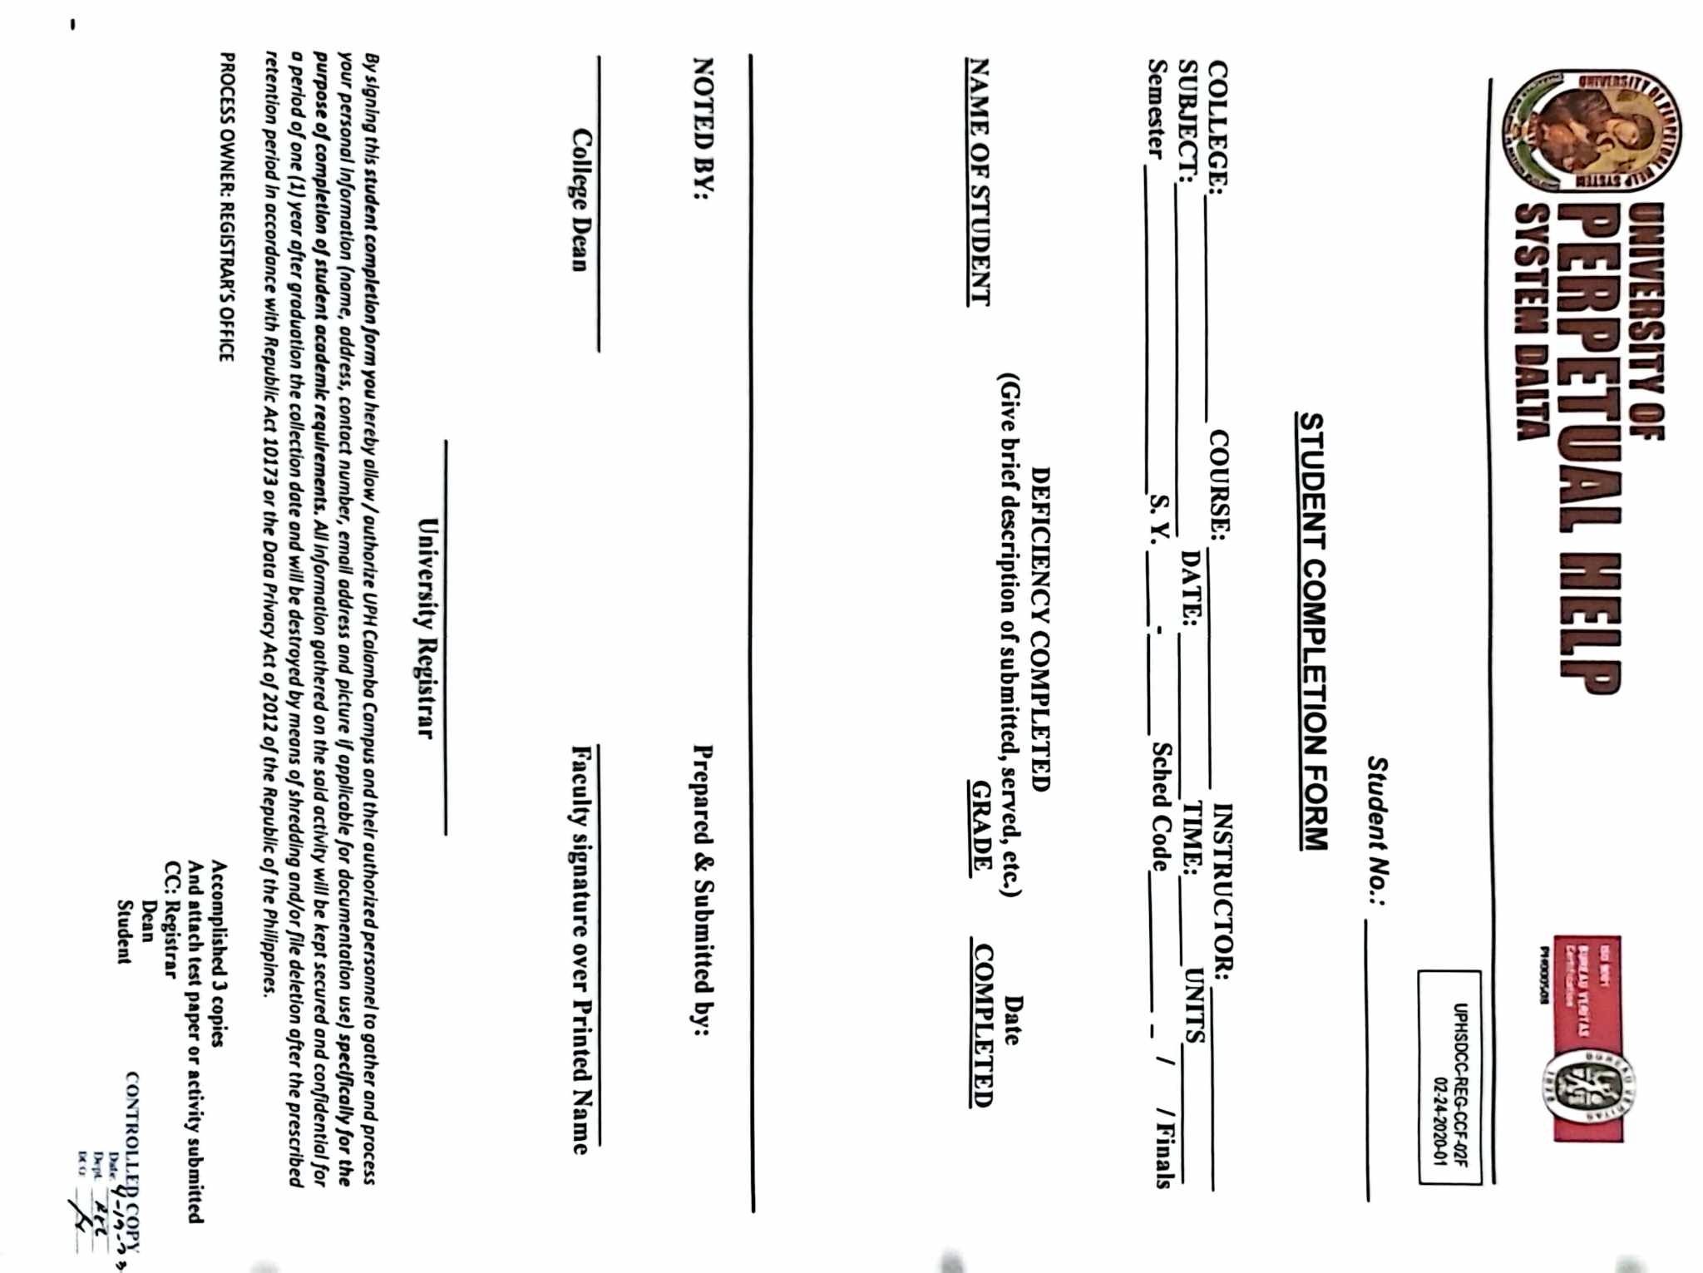
Completion Form:
Pay Php100 for every courses with INC grade at the Cashier.
Fill-out the Completion Form (
Duly signed completion form will be forwarded to the OUR
for proper modification in the School Automate.

Slide 16
Request and Issuance of School Records
OUR processes various documents/Records:
Diplomas
Official Transcript of Records
Form 137 / SF10
Form 138 / SF9
Form 9
Transfer Credentials
School Calendar
All types of Certifications
CHED Reports (E-Forms, Enrollment List, Special Order
Application etc.)
DepEd Reports (Learner’s Information System (LIS),
Enhanced Basic Education Information System (EBEIS),
Special Order Application etc.)
VMS – Voucher Management System in PEAC for Senior
High School
Bureau of Immigrations Compliance Reports/Documents
Local and International Verifications of Students Records
Others

Slide 17
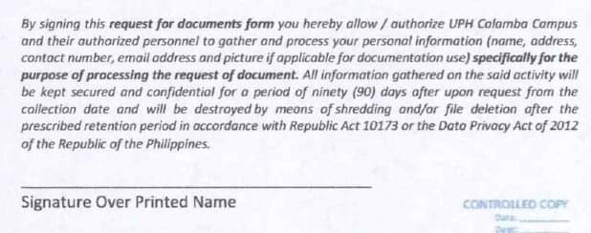
Guidelines for the request of documents
Accomplished request form and appropriate clearance must be presented.
Proof of payment/Receipt.
Anyone can request on behalf of the student with proper authorization.

Slide 18
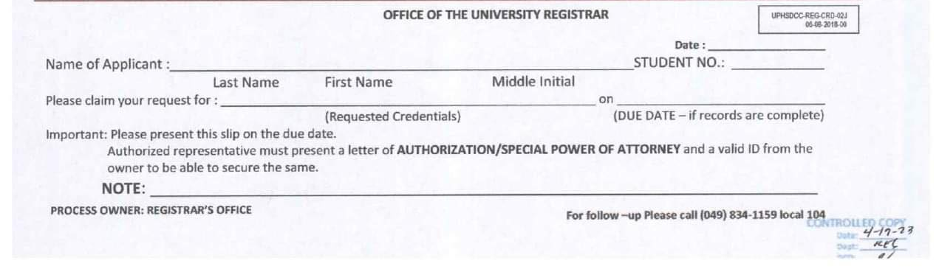
Guidelines for Releasing
Present the Claim Stub
Documents must be released ONLY to the student concerned.
In the event that the student cannot personally claim their requested document/s a Special Power of Attorney (SPA) for non-relative OR AUTHORIZATION Letter for immediate family members. Original ID of the student concern must be presented by the person claiming the documents.

Slide 19
Releasing of TOR and Diploma
The distribution of diplomas and transcripts during graduation ceremonies is a pivotal moment for both students and institutions. Here's a brief overview of how this process typically works and what to consider:
Preparation
Organizational Logistics
Verification and Identity
Post-Ceremony Procedures
Overall, the distribution of diplomas and transcripts during graduation is a significant and carefully orchestrated process that represents the culmination of academic achievement and marks the beginning of a new chapter for graduates.

Slide 20
Important Reminders:
School manuals are important because they explain the rules and procedures that everyone needs to follow. They help everyone understand how things work. Furthermore, having policies documented in a manual can help address any misunderstandings or disputes that may arise, as there is a tangible reference point available to all members of the school community.

Slide 21
Gamsahabnida
“We must adjust to changing times and still hold to unchanging principles.”
Jimmy Carter

